Slide 1
Urban Challenges
Metropolitan Perth; Perth metropolitan area

Slide 2

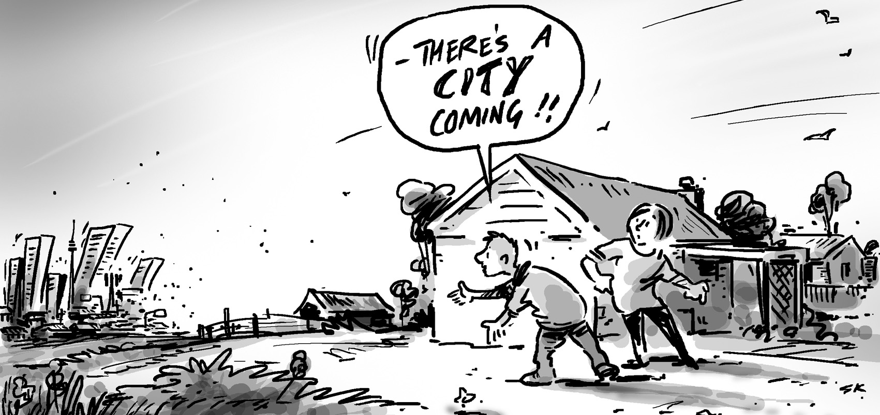
Congestion
Transportation
Urban sprawl
Housing

Slide 3
Urban Sprawl
Metropolitan Perth

Slide 4
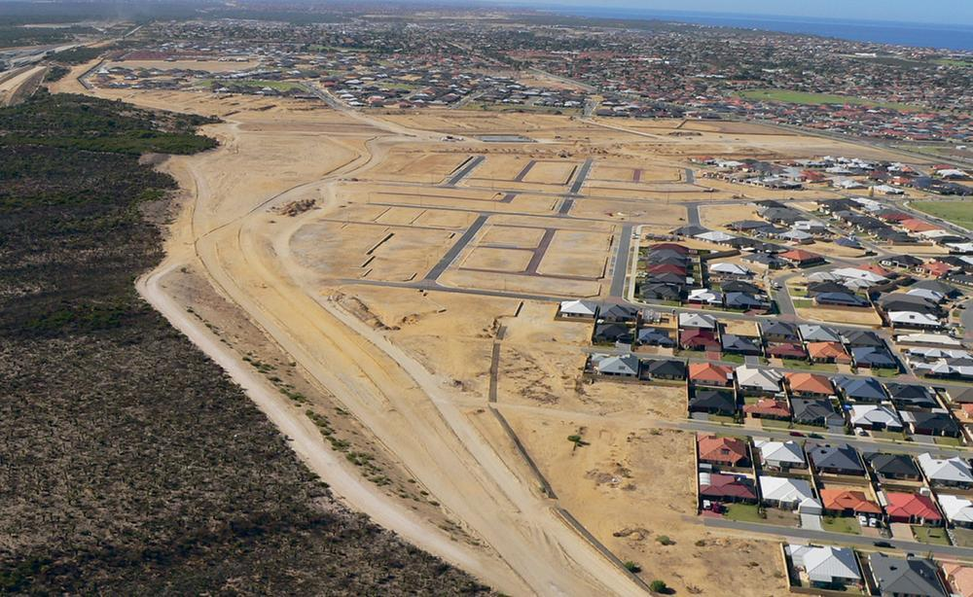

Slide 5
Nature & Scope
The low-density outward growth of urban areas into the surrounding rural lands and natural ecosystems.
Growth of a city into the surrounding hinterland.
Usually regarded as challenge and a process.
Occurs when the growth of a city is uncontrolled, rapid or unexpected; results in a significant lowering of population density.

Slide 6
Nature & Scope
Is the most prevalent challenge in metropolitan Perth.
Low density developments (i.e. detached dwelling on a single block) and estates are seen on the fringes of the city.

Slide 7
Examples
Butler and Jindalee – 40 km north of the CBD.
Ellenbrook – 25 km north-east of CBD.

Slide 8
Nature & Scope
Known as or referred to as ‘greenfield developments’.
‘Greenfields developments’ – involves the removal of native vegetation or farmland for housing.

Slide 9
Causes
Perth is experiencing population growth. Expected to increase from 2 million to 3.2 million by 2031.
Growth has increased demand for housing.
Transport links have provided accessibility. Encouraged people (residents) to seek cheaper land on the periphery of the city. E.g. the Kwinana Freeway and Mitchell Freeway.
Less accessibility to central Perth – means land use competition is lower ⇨ reduces land values.

Slide 10
Causes
Attracted first home buyers as well as younger families – larger blocks with detached homes.
Centrifugal forces – such as inner-city traffic congestion, pollution, crime and noise) push people and functions away from the centre of Perth. Attraction of cheaper land, new opens, larger blocks and open spaces pull people and functions to newer outer suburban areas.
Many suburbs offer a semi rural lifestyle – examples: Sawyers Valley, Upper Swan, Kalamunda.
Policies that encourage sprawl – growth of Perth has been strongly controlled by the original Corridor Plan.

Slide 11
Causes
The rapid population growth experienced by Perth in recent years put pressure on government to release land for residential development.
New housing estates on the fringe of the urban areas were quickly developed, some with large expanses of vacant land in between contributing to urban sprawl challenge.

Slide 12
Implications
Range of implications that can impact on the sustainability and liveability.
Demonstrates the urban process – i______________ and s_______________, as well as land use conflict in the Rural Urban Fringe (RUF).
Loss of arable land (land which could have been used for agricultural purposes, such as intensive agriculture – market gardens or orchards). Forces this type of land use further away. Increases cost of transportation, passed on to the consumer.

Slide 13
Implications
Urban Shadow Effect becomes an issue with invasion and succession.
Continual clearing of land – creates a loss of habitat of native flora and fauna. E.g. Carnaby’s Black Cockatoo. (Over last 45 years the population of the bird has decreased by 50%), due to land clearing and loss of food sources (native).

Slide 14
Implications
Higher government expenses – building on the periphery e.g. provision of infrastructure services – electricity, transportation networks, education facilities, water etc…
Lack of urban amenity – often all the houses contain similar characteristics and lack greenery (reduces attractiveness of the area).
Limited community facilities and social infrastructure - due to threshold population and costs.

Slide 15
Implications
Increased distance from places of employment – including congestion.
Places develop further away – means higher reliance on cars, so increased car ownership. People spend more time travelling to and from work.

Slide 16
SEE - Costs
Social:
Isolation
Public health issues
Longer commuting times
Loss of family time
Deterioration of inner suburbs
Loss of disposable income to transport costs

Slide 17
SEE - Costs
Economic:
Building new roads
Loss of farmland
Providing hospitals, schools, shopping centres.
Providing services: electricity and water
Additional burden on national, state and local economies.
Transportation costs
Under-utilised inner-city infrastructure
Provision of services and infrastructure costs on average is $136,000 per lot when located 40 kilometres from the CBD.

Slide 18
SEE - Costs
Environmental:
Loss of natural ecosystems
Extinction of species
Pollution
Energy consumption
Disruption of natural cycles: heat budget, carbon, water
Habitat loss
Greenhouse gases

Slide 19
Planning Strategies
Major planning schemes and policies including The Corridor Plan (1970’s), Metroplan, Network City and Directions 2031 have been responsible for shaping Perth’s growth since 1970.
Initial plan – encouraged growth of Perth along four main corridors, while recent planning schemes and strategies have encouraged urban redevelopment and urban infill.

Slide 20
Planning Strategies
The Metropolitan Redevelopment Authority (MRA) is aiming to provide sustainable and dynamic places to work and live in Perth.
E.g. Elizabeth Quay – one of the main developments in the city. Construction started in 2012. Plan involves mixed land use . Designed to be an outdoor entertainment venue. Aim upon completion is for 1400 residential population. (Page 265)
The current working plan Directions 2031 and Beyond, has advocated 47% urban infill. Plus it is in Perth and Peel @3.5 Million

Slide 21
Planning Strategies
East Perth Redevelopment Program – deliberate rejuvenation of IMZ. The region was transformed from an area of large-scale industry (light) and low socio-economic residences, to more affluent and expensive townhouses and apartments. – Page 264
Infilling and consolidation – Page 262 - 264

Slide 22
Planning Strategies – Perth and Peel @3.5 Million
Perth and Peel @3.5 Million builds on Directions 2031 with its main aims being to slow down urban sprawl, although identifying that ______________ new dwellings will be required to accommodate the extra 1.5 million people expected to live in Perth by _______.
380,000 of the new residences are earmarked as infill and 215,000 to be built in the Central sub-region.

Slide 23
Planning Strategies – Perth and Peel @3.5 Million
Perth and Peel @3.5 Million

Slide 24
Planning Strategies
LOOK at Perth and Peel @3.5 Million.
Other???
Discuss and brainstorm

Slide 25
STAKEHOLDERS
List examples: Discuss

Slide 26
Article: Ninety-four percent of Perth councils fail to hit new housing targets. By: Emma Young, Hamish Hastie, David Allan-Petale and Nathan Hondros & Conal Hanna (September 3, 2018)
Summary:
Thirty of 32 Perth councils have failed to hit infill development tragets set by the state government.
In 2011, the state government set each council a target for new net infill dwellings based on the need to accommodate 800,000 new homes across Perth by 2050.
The first interim measuring post was set at 2016, Claremont and Belmont only councils to achieve their targets.

Slide 27
Comparing Planning Strategies – Other cities in and out of Australia
Melbourne
Adelaide
Wellington, NZ

Slide 28
Case Study – Manila, Philippines
Read the text and take key summary notes on file paper.
Allow 10 minutes
Page 266-267

Slide 29
Congestion
Metropolitan Perth

Slide 30
What is it?
Traffic congestion occurs when there is an increase usage of transport networks which are not designed for the larger number of users.
Occurs when the flow of vehicles along road networks is slowed.

Slide 31
What happens?
It means that users of the network experience slower speeds, increase queuing on major networks (freeways and arterial roads) and longer trip times.

Slide 32
When does it happen? Congestion
Traffic congestion occurs when there is an increase usage of transport networks which are not designed for the larger number of users. (Atkinson et al, 2016)
Congestion occurs during peak hours.
Between 6:30am to 9:00am and from 4:30pm to 6:30pm.

Slide 33
Why?
High population growth in the last decade →increase pressure on Perth’s public transport network and road infrastructure

Slide 34
Nature & Scope
Major urban challenge in Perth.
Occurs when the flow of vehicles along the road network is slowed.
Serious challenge for commuters that travel both in and out of inner city areas, such as IMZ and CBD especially during peak times (7-9am and 4-6pm).
Car users utilising the freeways (especially the Mitchell Freeway) and major roads (for example Marmion Avenue) suffer long delays.
Congestion is a sign or indicator that the transport network is struggling.

Slide 35

Perth has been experiencing unprecedented population growth – more people travelling within the city.
Between 2009-2014 number of registered vehicles increased by 17%.

Slide 36
Causes
Low density population distribution
Urban sprawl – congestion is often linked to the challenge of urban sprawl. (So minimising sprawl reduces the reliance people have on their cars)
Limited public transport options for outer suburbs. E.g. Ellenbrook, Alkimos
Concentration of employment – in and around CBD – emphasis of working in the CBD. E.g. approximately 100,000 people converge on CBD each day.
Limited river crossings – routes in and out of CBD
High reliance on cars – congestion occurs on freeways due to continuous need to merge.
Low vehicle occupancy – (90% of cars in Perth contain only one person)

Slide 37
Causes
Increasing low-density outward growth of Perth has contributed to and impacted on provision of public transport system (inadequate) ⇨ increased reliance on the motor car.
Supporting evidence – many new suburbs, such as Aveley, Piara Waters, Alkimos are not well serviced by public transport, thus people rely on cars for accessibility.
Improved living standards have made the private car more affordable. Perth has 1.8 cars per household.

Slide 38
Causes
Over-emphasis on Perth CBD as an employment centre contributes – people travel in and out of the CBD. Many roads are not designed to carry large volumes of traffic, such as Cambridge Street, William Street and Beaufort Street.
The Kwinana and Mitchell Freeways can not cope with peak hour traffic, with the amount of converging traffic continually slowing flow.
Graham Farmer Freeway carries more than 110,000 vehicles a day.

Slide 39
Causes
Increased number of commercial vehicles and trucks have contributed to traffic issues, as they transport goods between the major industrial areas and transport focal points, such as airports and port.

Slide 40
Implications
Number of serious problems in relation to an increase in carbon dioxide emissions, thus increase in pollution.
Fuel consumption is increased.
Economic loss of productivity as people are caught in traffic.
Stress and anti-social behaviour – increasing incidences of road rage in Perth.
Motorists taking short cuts or ‘rat runs’ to avoid certain areas renowned for congestions – particularly in quiet neighbourhoods.

Slide 41
Implications
Parking of vehicles – can also have financial implications.
Developers must provide significant amounts of land close to city
Forced street parking can lead to conflict, as narrowing the street for vehicles to move through.

Slide 42
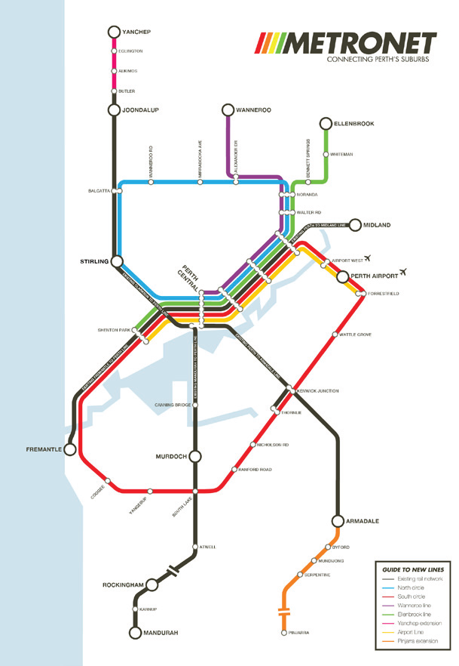
Planning Strategies – METRONET

Slide 43
METRONET
Long term blueprint to connect suburbs – public transport program
Connect suburbs - Reduce road congestion (CONGESTION – Challenge)
Meet Perth’s future planning needs.
Will create employment
World –class public transport system for Perth (TRANSPORTATION – Challenge)
First Stage…
Completing Forrestfield-Airport Link
Yanchep Rail Extension – Alkimos, Eglinton and Yanchep connecting the fast-growing northern suburbs. 13.8KM of new rail. (49 minute journey from Yanchep to Perth, 3 new stations)Approximately $386 million
Planning and building the new Morley-Ellenbrook Line – Approximately $863 million
Extending Armadale line to Byford – Approximately $291 million

Slide 44
METRONET
METRONET vision:
A well connected Perth with more transport, housing and employment choices.
https://www.metronet.wa.gov.au/

Slide 45
Melbourne – Addressing the Urban Challenges
Complete the A4 handout – Using the Melbourne planning document.

Slide 46
Measures to manage congestion in Singapore
Integrated Public Transport System
Connects various modes of transportation
Encourages people to use public transport.
DOES THIS COMPARE TO PERTH?

Slide 47
Measures to manage congestion in Singapore
Enhanced traffic monitoring
Traffic monitoring can alert drivers of traffic congestion.
Singapore uses a traffic monitoring system called EMAS – Expressway Monitoring and Advisory System.
Live information is provided and made available to drivers on the roads about the situation, such as a crash or vehicle breakdown.

Slide 48
Measures to manage congestion in Singapore
https://www.onemotoring.com.sg/content/onemotoring/en/on_the_roads/traffic_management/intelligent_transport_systems/emasys.html

Slide 49
Measures to manage congestion in Singapore
Another traffic monitoring system is the GLIDE – Green Link Determining system.
Computerised traffic light signalling system which detects vehicles and pedestrians at major intersections (road junctions), then adjusts the green time according to the traffic conditions.
DOES THIS COMPARE TO PERTH?

Slide 50
Transportation
Metropolitan Perth

Slide 51
Over to you…
You need to complete notes from your book for Transportation…
It is your responsibility to get this section completed.

Slide 52
Sustainability – Gateway WA Project
Read page 258
Complete summary notes under the following headings:
SOCIAL
ECONOMIC
ENVIRONMENTAL

Slide 53
Planning Strategies – Forrestfield Airport Link
Read page 258
Complete summary notes under the following headings:
SOCIAL
ECONOMIC
ENVIRONMENTAL

Slide 54
Planning Strategies – Metronet

Slide 55
Metronet
Long term blueprint to connect suburbs
Reduce road congestion
Meet Perth’s future planning needs.
Will create employment
World –class public transport system for Perth (TRANSPORTATION – Challenge)
First Stage…
Completing Forrestfield-Airport Link
Yanchep Rail Extension – Alkimos, Eglinton and Yanchep connecting the fast-growing northern suburbs. 13.8KM of new rail. (49 minute journey from Yanchep to Perth, 3 new stations)Approximately $386 million
Planning and building the new Morley-Ellenbrook Line – Approximately $863 million
Extending Armadale line to Byford – Approximately $291 million

Slide 56
Planning Strategies – METRONET
Complete summary notes under the following headings:
SOCIAL
ECONOMIC
ENVIRONMENTAL

Slide 57
Housing
Metropolitan Perth

Slide 58
Over to you…
You need to complete notes from your book for Housing…
Provision of Housing – Pages 234 – 241
It is your responsibility to get this section completed.

